Slide 1
Numerical analysis of coupled mode conversion in plasma with sheared magnetic field
Xinhang Xu
8/6/2024

Slide 2
Abstract
Motivation
Research steps
General equation for analyzing the coupled mode conversion
Numerical method
Numerical benchmark with typical case
Propagation in the sheared magnetic field
Mode-conversion analysis
Summary

Slide 3


Motivation
FIRTIP
High k Scattering diagnose
Launch mode
Right rotation polarization
&
Left rotation polarization
Linear polarization mode
Spherical Tokamak
Faraday rotation in Sheard magnetic field
The phase might be shift by the sheared magnetic field, adding the error in the electron density measurement
The scattering polarization is strongly correlated with the launch beam polarization, which will influent our receiver intensity

Slide 4


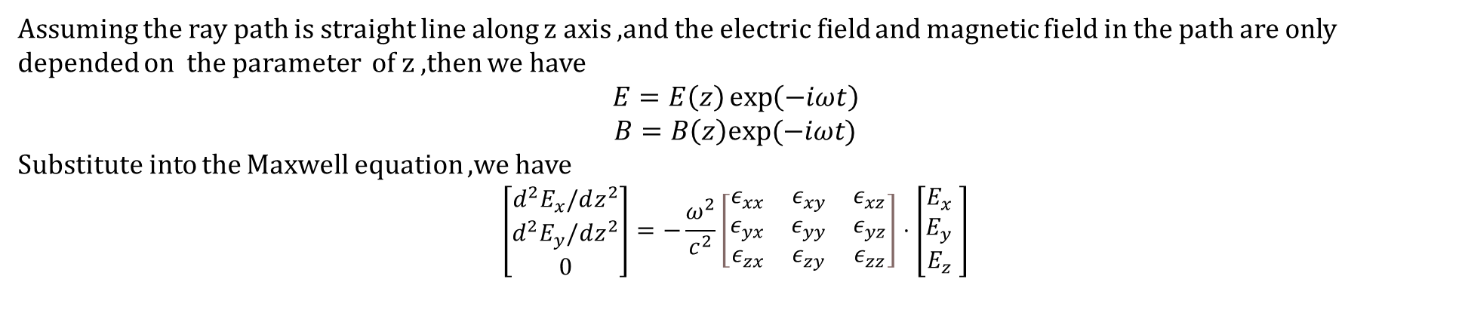
General equation
According to the Maxwell equations, we have
$$∇×B=μ_{0}ε_{0}\overset{̿}{ε}⋅\frac{∂E}{∂t}$$
$$∇×E=−\frac{∂B}{∂t}$$
$$\overset{̿}{ε}=\left[\begin{matrix}ε_{xx} & ε_{xy} & ε_{xz} \\ ε_{yx} & ε_{yy} & ε_{yz} \\ ε_{zx} & ε_{zy} & ε_{zz}\end{matrix}\right]$$
where
Assuming the ray path is straight line along z axis ,and the electric field and magnetic field in the path are only depended on the parameter of z ,then we have
$$E=E\left(z\right)\exp\left(−iωt\right)$$
$B=B\left(z\right)exp⁡(−iωt)$
Substitute into the Maxwell equation ,we have
$$\left[\begin{matrix}d^{2}E_{x}/dz^{2} \\ d^{2}E_{y}/dz^{2} \\ 0\end{matrix}\right]=−\frac{ω^{2}}{c^{2}}\left[\begin{matrix}ε_{xx} & ε_{xy} & ε_{xz} \\ ε_{yx} & ε_{yy} & ε_{yz} \\ ε_{zx} & ε_{zy} & ε_{zz}\end{matrix}\right]⋅\left[\begin{matrix}E_{x} \\ E_{y} \\ E_{z}\end{matrix}\begin{matrix} \\ \\ \end{matrix}\right]$$

Slide 5
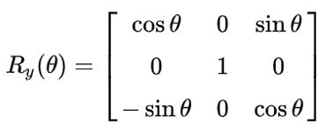
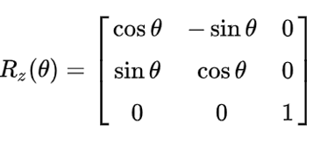
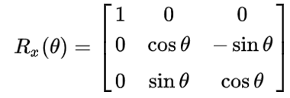
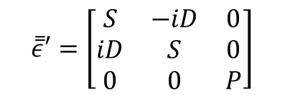
General equation
In cold plasma with magnetic field along z axis,the dielectric tensor can be expressed as
$$\overset{̿}{ε}′=\left[\begin{matrix}S & −iD & 0 \\ iD & S & 0 \\ 0 & 0 & P\end{matrix}\right]$$
If the magnetic field direction change to new direction ,the rotation angle can be expressed as Rc=Rz*Ry*Rx
Then the dielectric tensor is
$$\overset{̿}{ε}=Rc∗{\overset{̿}{ε}}^{′}∗Rc′$$
Rc’ means inverse matrix of Rc

Slide 6
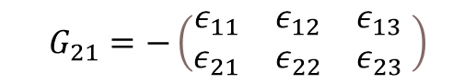
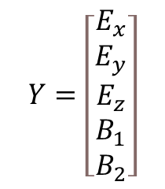
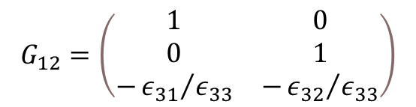
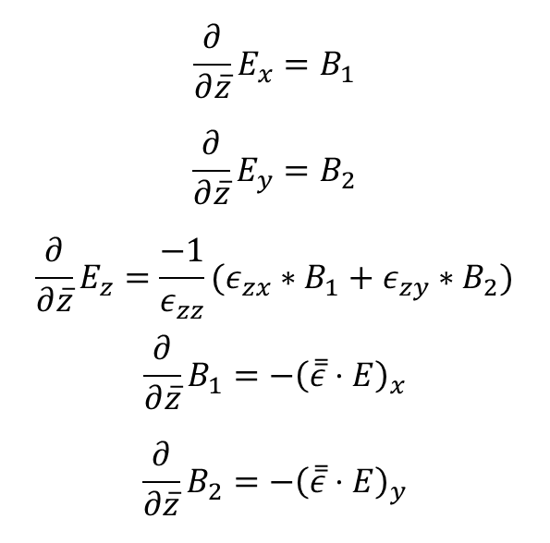
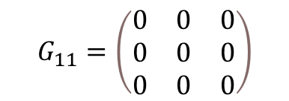
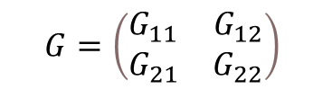
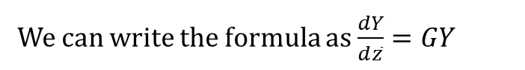
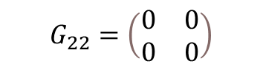
Numerical method
$$\frac{∂}{∂\overline{z}}E_{x}=B_{1}$$
$$\frac{∂}{∂\overline{z}}E_{y}=B_{2}$$
$$\frac{∂}{∂\overline{z}}E_{z}=\frac{−1}{ε_{zz}}(ε_{zx}∗B_{1}+ε_{zy}∗B_{2})$$
$$\frac{∂}{∂\overline{z}}B_{1}=−{\left(\overset{̿}{ε}⋅E\right)}_{x}$$
$$\frac{∂}{∂\overline{z}}B_{2}=−{\left(\overset{̿}{ε}⋅E\right)}_{y}$$
We can write the formula as $\frac{dY}{d\overline{z}}=GY$
$$Y=\left[\begin{matrix}E_{x} \\ E_{y} \\ E_{z} \\ B_{1} \\ B_{2}\end{matrix}\right]$$
$$G=\left(\begin{matrix}G_{11} & G_{12} \\ G_{21} & G_{22}\end{matrix}\right)$$
(Gauss Law)
$$G_{11}=\left(\begin{matrix}0 & 0 & 0 \\ 0 & 0 & 0 \\ 0 & 0 & 0\end{matrix}\right)$$
$$G_{12}=\left(\begin{matrix}\begin{matrix}1 & 0 \\ 0 & 1 \\ −{ε_{31}}/{ε_{33}} & −{ε_{32}}/{ε_{33}}\end{matrix}\end{matrix}\right)$$
$$G_{21}=−\left(\begin{matrix}ε_{11} & ε_{12} & ε_{13} \\ ε_{21} & ε_{22} & ε_{23}\end{matrix} \right)$$
$$G_{22}=\left(\begin{matrix}0 & 0 \\ 0 & 0\end{matrix}\right)$$

Slide 7



Crank-Nicolson method for $\frac{dY}{d\overline{z}}=GY$
$$Y^{n+1}−Y^{n}=\frac{1}{2}Δ\overline{z}G\left(Y^{n+1}+Y^{n}\right)$$
$$\left(I−\frac{1}{2}Δ\overline{z}G\right)Y^{n+1}=\left(I+\frac{1}{2}Δ\overline{z}G\right)Y^{n}$$
Iteration function is
$$Y^{n+1}={\left(I−\frac{1}{2}Δ\overline{z}G\right)}^{−1}∗\left(I+\frac{1}{2}Δ\overline{z}G\right)Y^{n}$$

Slide 8
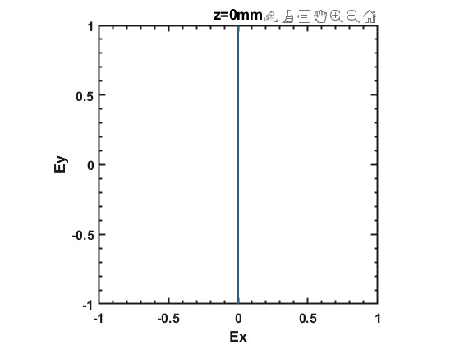
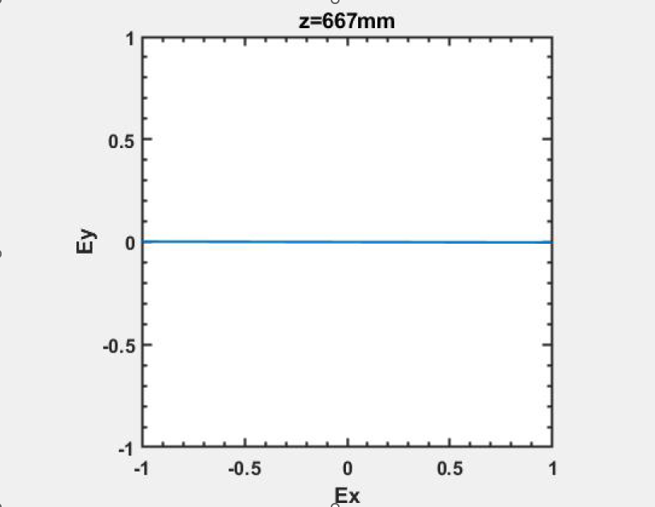
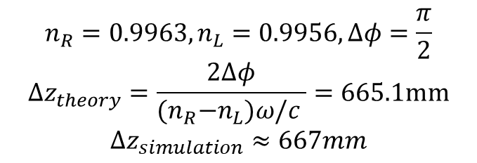
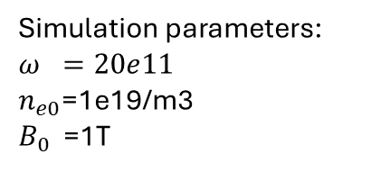
Numerical test with typical case
1. Faraday Rotation
B0
k
E
Simulation parameters:
$$ω =20e11$$
$n_{e0}$=1e19/m3
$B_{0}$ =1T
$$n_{R}=0.9963,n_{L}=0.9956,Δφ=\frac{π}{2}$$
$$Δz_{theory}=\frac{2Δφ}{{(n}_{R}−n_{L})ω/c }=665.1mm$$
$$Δz_{simulation}≈667mm$$

Slide 9
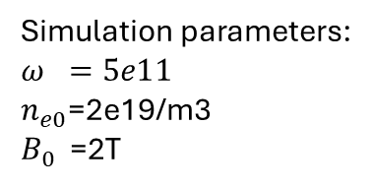
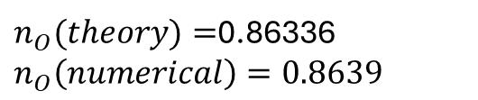
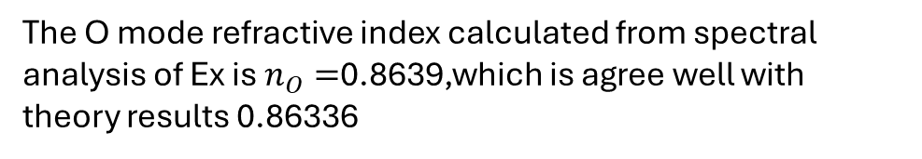
2. X mode and O mode
O mode
k
E
B₀
Simulation parameters:
$$ω =5e11$$
$n_{e0}$=2e19/m3
$B_{0}$ =2T
$n_{O}(theory)=$0.86336
$$n_{O}\left(numerical\right)=0.8639$$
The O mode refractive index calculated from spectral analysis of Ex is $n_{O}=$0.8639,which is agree well with theory results 0.86336

Slide 10
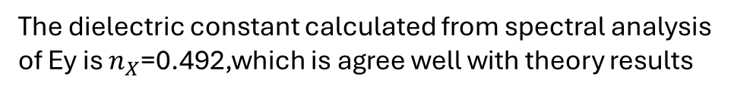
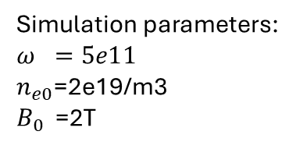
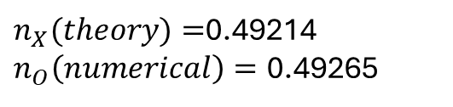
2. X mode and O mode
X mode
k
E
B₀
Simulation parameters:
$$ω =5e11$$
$n_{e0}$=2e19/m3
$B_{0}$ =2T
$n_{X}(theory)=$0.49214
$n_{O}\left(numerical\right)=\text{0.492}$65
The dielectric constant calculated from spectral analysis of Ey is $n_{X}$=0.492,which is agree well with theory results

Slide 11
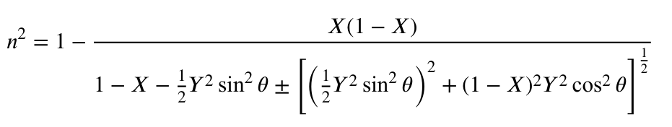
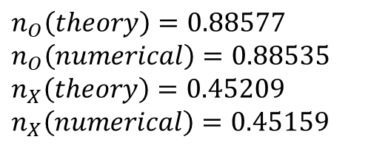
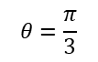
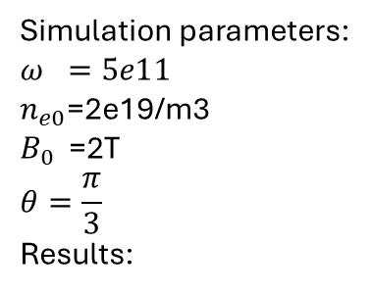
Oblique propagation
k
E
$$θ=\frac{π}{3}$$
B₀
Simulation parameters:
$$ω =5e11$$
$n_{e0}$=2e19/m3
$B_{0}$ =2T
$$θ=\frac{π}{3}$$
Results:
fft
$$n_{O}\left(theory\right)=0.88577$$
$$n_{O}\left(numerical\right)=0.88535$$
$$n_{X}\left(theory\right)=0.45209$$
$$n_{X}\left(numerical\right)=0.45159$$

Slide 12
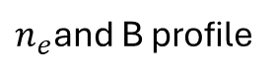
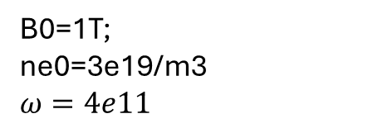
Cutoff layer
$n_{e}$and B profile
k
B₀
B0=1T;
ne0=3e19/m3
$$ω=4e11$$
Ex field forms a standing wave and is blocked at the boundary of cutoff layer ,while E0 field is not blocked
Refractive index of O mode and X mode
X mode cutoff

Slide 13

Strange phenomenon
Setup the background
k
$$β$$
B₀
K always parallel to z
omega =3e11;
ne0=5e19;
B0 =1;
beta= pi/3.0;

Slide 14
Strange phenomenon
Cutoff layer
Resonant layer
When the cutoff layer close to resonant layer of X mode , the electrostatic field near the resonant layer will be very strong ,why ?

Slide 15
1D EMW Simulation development
Input plasma parameters
Input plasma parameters
Will do
Using the straight line as ray path
Initialize Ray Tracing,
Get the main path of the ray
Discrete the path, Calculate the rotation matrix at each line grid
Discrete the path, Calculate the rotation matrix at each line grid
Calculate refractive index n
Calculate refractive index n
All(n)>0
Exit(n)<0
All(n)>0
Exit(n)<0
Buildup the evolution matrix
Buildup the global matrix
Buildup the evolution matrix
Buildup the global matrix
Solve the Maxwell equations
Solve the Maxwell equations
Data analysis
Data analysis

Slide 16
Backup case

Slide 17
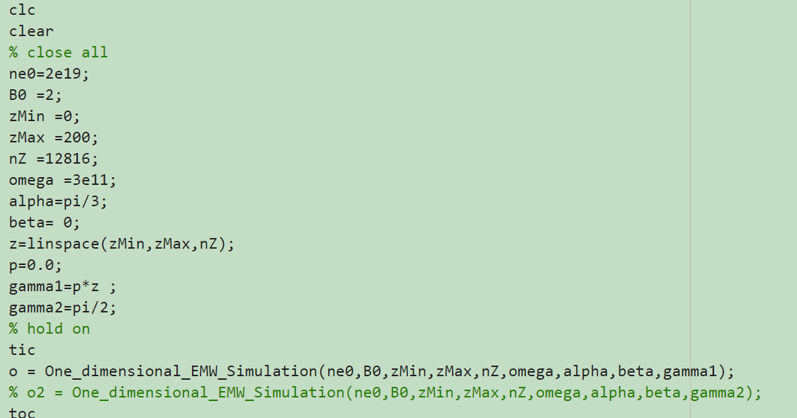

Slide 18
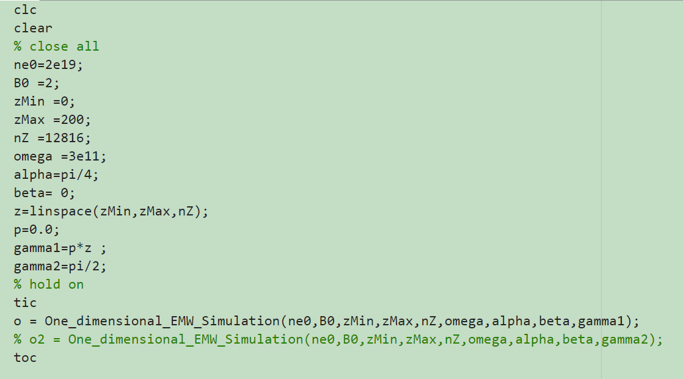

Slide 19
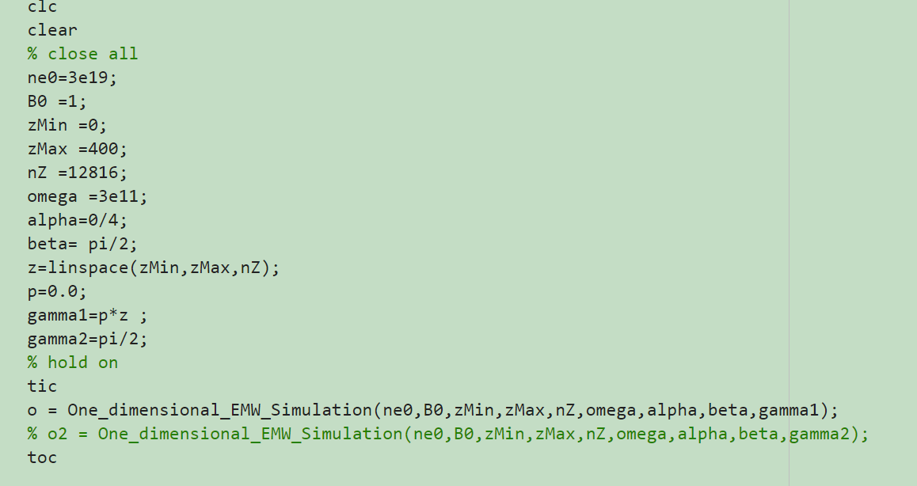

Slide 20
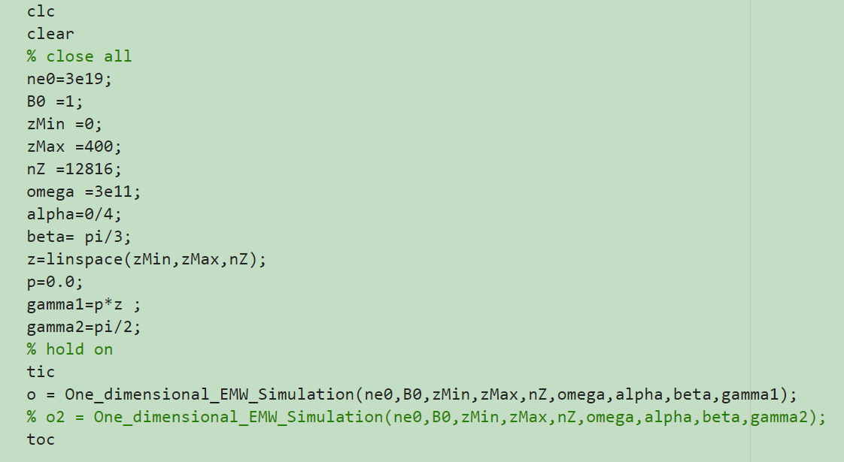

Slide 21
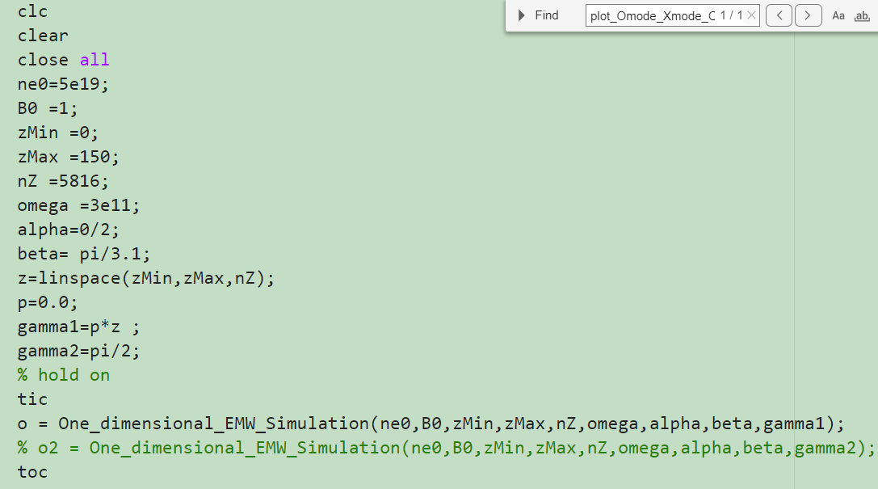
One Strange Phenomenon near the cutoff and resonant layer

Slide 22
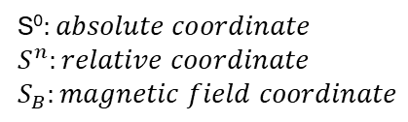

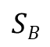
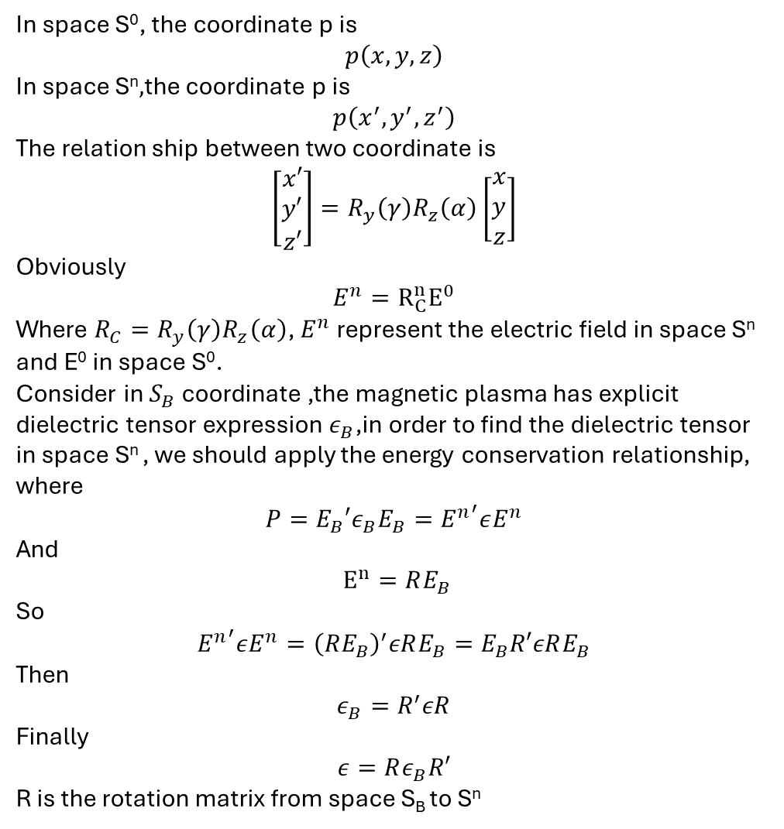
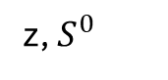


In space S⁰, the coordinate p is
$$p\left(x,y,z\right)$$
In space S^{n}$,$the coordinate p is
$$p\left(x^{′},y^{′},z^{′}\right)$$
The relation ship between two coordinate is
$$\left[\begin{matrix}\begin{matrix}x′ \\ y′ \\ z′\end{matrix}\end{matrix}\right]=R_{y}\left(γ\right)R_{z}\left(α\right)\left[\begin{matrix}x \\ y \\ z\end{matrix}\right]$$
Obviously
$$E^{n}=R_{C}^{n}E^{0}$$
Where $R_{C}=R_{y}\left(γ\right)R_{z}\left(α\right)$, $E^{n}$ represent the electric field in space S^{n} and E⁰ in space S⁰.
Consider in $S_{B}$ coordinate ,the magnetic plasma has explicit dielectric tensor expression $ε_{B}$,in order to find the dielectric tensor in space S^{n} , we should apply the energy conservation relationship, where
$$P=E_{B}′ε_{B}E_{B}={E^{n}}^{′}εE^{n}$$
And
$E^{n}=RE_{B}$
So
$${E^{n}}^{′}εE^{n}={\left(RE_{B}\right)}^{′}εRE_{B}=E_{B}R′εRE_{B}$$
Then
$$ε_{B}=R^{′}εR$$
Finally
$$ε=Rε_{B}R′$$
R is the rotation matrix from space S_{B} to S^{n}
z, $S^{0}$
$$SB$$
$$S^{n}$$
p
$$γ$$
y
$$α$$
S⁰$:absolute coordinate$
$$S^{n}:relative coordinate$$
$$S_{B}:magnetic field coordinate$$
x

Slide 23
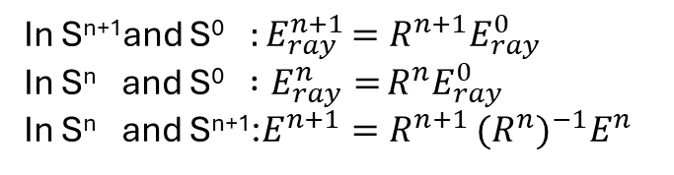
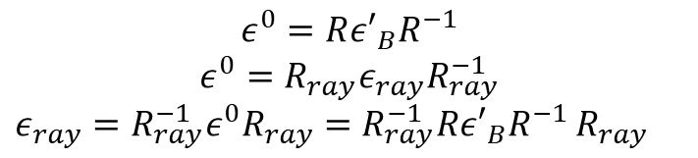
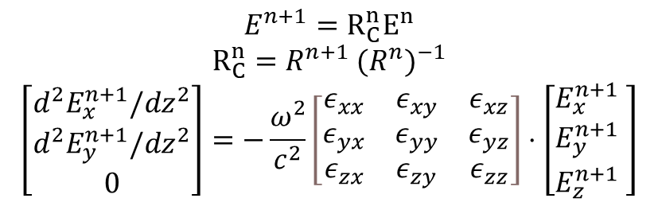
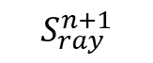
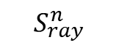

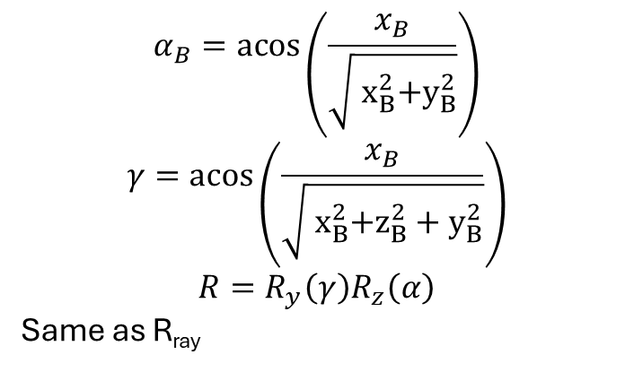
Rotation matrix R
$$S_{0}$$
How to calculate rotation matrix from space S_{B} to S^{n+1} ?
$$S_{ray}^{n}$$
$$ε^{0}=R{ε′}_{B}R^{−1}$$
$$ε^{0}={R_{ray}ε}_{ray}R_{ray}^{−1}$$
$ε_{ray}={R_{ray}^{−1}ε}^{0}R_{ray}=R_{ray}^{−1}R{ε′}_{B}R^{−1}$ $R_{ray}$
$$S_{ray}^{n+1}$$
In S^{n+1}and S⁰ ${:E}_{ray}^{n+1}=R^{n+1}E_{ray}^{0}$
In S^{n} and S⁰$:E_{ray}^{n}=$ $R^{n}E_{ray}^{0}$
In S^{n} and S^{n+1}:$E^{n+1}=R^{n+1}$ ${{(R}^{n})}^{−1}E^{n}$
In absolute coordinate,$S_{B}$direction is n_{B}= (x_{B},y_{B},z_{B}), S_{ray} direction is (x,y,z)
$$α_{B}=\operatorname{acos}\left(\frac{x_{B}}{\sqrt{{ x}_{B}^{2}+y_{B}^{2}}}\right)$$
$$γ=\operatorname{acos}\left(\frac{x_{B}}{\sqrt{{ x}_{B}^{2}+z_{B}^{2}+y_{B}^{2}}}\right)$$
$$R=R_{y}\left(γ\right)R_{z}\left(α\right)$$
Same as R_{ray}
$$E^{n+1}=R_{C}^{n}E^{n}$$
$R_{C}^{n}=R^{n+1}$ ${{(R}^{n})}^{−1}$
$$\left[\begin{matrix}d^{2}E_{x}^{n+1}/dz^{2} \\ d^{2}E_{y}^{n+1}/dz^{2} \\ 0\end{matrix}\right]=−\frac{ω^{2}}{c^{2}}\left[\begin{matrix}ε_{xx} & ε_{xy} & ε_{xz} \\ ε_{yx} & ε_{yy} & ε_{yz} \\ ε_{zx} & ε_{zy} & ε_{zz}\end{matrix}\right]⋅\left[\begin{matrix}E_{x}^{n+1} \\ E_{y}^{n+1} \\ E_{z}^{n+1}\end{matrix}\begin{matrix} \\ \\ \end{matrix}\right]$$

Slide 24
E(i)
H(i)
E(i+1)
H(i+1)
E(i+2)

